Slide 1
San Francisco State University

Slide 2
Student Activities & Events presents:
Student Organization Advisor Training
Mia S. Reisweber, PhD
Director | Student Activities & Events
mreisweber@sfsu.edu
Updated Summer 2020

Slide 3
A letter to our advisors
Dear Advisor,
Thank you for committing your time to be an advisor for a student organization here at SF State. Your service to students in this role is integral in their development academically, professionally, and personally. Advising a student organization is like mastering your favorite cooking recipe. The base is understanding the policy and procedure that supports and protects our students and the university. The flavor is the guidance and support you provide in their programming and event initiatives, their personal and professional development, and the learning you cultivate along the way. The whole thing comes together when you determine your advising style and intentionally build relationships with each of you students.
This guide is one of the resources we are providing to support you in your journey as an advisor. It contains vital information for you as an advisor and for your student organization members. Our goal in Student Activities and Events is to support you as well as our students.
We hope your advisor experiences is rewarding. Please contact us if you have any questions or ideas, and please reach out to us if you feel overwhelmed. Again, welcome! We are thrilled to have you as part of our Student Activities and Events family.
Appreciatively Yours,
Your Student Activities & Events Team
Mia Reisweber | Lee Twyman | Vernon Piccinotti
Gabriela Ballesteros | Tony Robbins

Slide 4
Overview of Presentation
Student Activities & Events organizational structure and contact information
The Role of an Advisor
Advisor Resources and Tools
Major Policies
The Heart of Student Organizations

Slide 5
Student Activities & Events

Slide 6
Organizational Structure of the Student Activities & Events
Dr. Lynn Mahoney
SF State President
Dr. Beth Hellwig
Vice President of Student Affairs
Dr. Danny Glassmann
Dean of Students
& AVP of Student Life
Dr. Mia Reisweber
Director of Student Activities & Events
Anthony (Tony) Robbins
Administrative Support
Monolito (Lee) Twyman
Assistant Director of Activities
Vernon Piccinotti
Assistant Director of Events
Gabriela (Gabi) Ballesteros
Greek Life Advisor

Slide 7
Student Activities & Events
Mia Reisweber, PhD | Director of Student Activities & Events
Mia has a foundation in pedagogy and curriculum design. She is the head of the department and supports the advisor cohort directly.
Monolito (Lee) Twyman | Assistant Director of Activities
With over 20 years of higher education experience, Lee is leading the support of student organization and co-developing learning curriculum for the department. Proud SF State graduate.
Vernon Piccinotti | Assistant Director of Events
A Master of events and technical management, Vernon leads the departments work in event management for the Student Life & Events Center (SLEC) and supporting student organization and SF State sponsored events. Proud SF State graduate.
Gabriela (Gabi) Ballesteros | Student Life Coordinator & Greek Life Advisor
Gabi works directly with our over 270 registered student organizations, with a specialization in our nearly 45 charted Greek chapters at SF State. Gabi brings a curriculum background to the team, as well, and is currently working through a Doctoral program at Sac State. Proud SF State graduate.
Tony Robbins | Administrative Support
Tony is a long-time alumnus and veteran of SF State. He works to support the Student Life & Events Center operations and departmental affairs. His passion is working for the students

Slide 8
Getting in Contact with the Student Activities & Events Team
Give us a call or email us!
Mia: 415.338.6119 | mreisweber@sfsu.edu
Lee: 415.405.4026 | monolito@sfsu.edu
Vernon: 415.405.3603 | vjp@sfsu.edu
Gabi: 415.405. 3978 | gdballes@sfsu.edu
Tony: 415.338.3629 | arobbins@sfsu.edu
Stop by!
Our team’s suite is located at the Student Life & Events Center (SLEC) in Annex 1 down near the Corp Yard. It’s only a 15 minute walk from the Admin building!
Have a generic question? You can always email activities@sfsu.edu and one of our team members will get back to your shortly.

Slide 9
Role of the Advisor

Slide 10
The Role of the Advisor
Advisor Eligibility
To serve as an advisor to a student organization at SF State, a person must be a university employee (not of an auxiliary entity). Eligible employees must complete the Advisor Orientation and the Advisor Registration process. Additionally, the advisor has to be located on campus. An advisor on sabbatical or on an extended leave of absence should identify an alternative advisor during their absence from campus.

Slide 11
The Role of the Advisor
Advisor Expectations
Be familiar with their organization’s constitution and bylaws
If applicable, be familiar with the constitution and bylaws of the organization’s inter/national affiliate
Assist Student Activities & Events and San Francisco State University in upholding university policy
Ensure the organization is registered appropriately
Facilitate their student organization through the reregistration process
Be willing to assist their student organization members with programming questions, the event planning and request process, banking processes, and funding requests
Determine an alternate advisor in the event of an extended absence (sabbatical, medical leave, leave of absence, teaching abroad, etc.). All alternate advisors must be reported ASAP to Student Activities and Events.
Never project own agenda on student organization or manipulate the student organization into serving your own personal or professional needs.
Never make decisions for the organization or its members.

Slide 12
The Role of the Advisor
Roles of the Advisor
The advisor to a student organization contributes to the success of each of the students and of the organization. While the constitution and the bylaws of a student organization might remain relatively similar from year-to-year, the longer you serve in this role, the more you will see the variations of you student organization. Dynamics can change with the student leadership, the active members, and the programmatic goals of the club. With this, advising styles can shift from year to year, semester to semester or even week to week.
Below is a list of some of the roles you may assume as an advisor:
Mentor
Team Builder
Conflict Manager
Reflective
Agent
Educator
Motivator
Policy Interpreter
Cheerleader

Slide 13
Advising Styles
Directing: The advisor provides specific instructions and closely supervises task accomplishments. Many times, advisors may struggle with students because they believe that they need a higher level of interaction or direction when the student is actually able to accept more of a delegating style and vice versa
Coaching: The advisor continues to direct and closely supervise task accomplishments, but also explains decisions, solicits suggestions, and supports progress. Use this style with groups that have a few leaders that are at a higher readiness level who will need your support with the rest of the group to get things accomplished.
**This does not mean that the advisor can also be the coach for Sport Clubs. This is a strategy, not an official title. Coaches are not allowed to also hold advisor positions.
Supporting: The advisor facilitates and supports the efforts toward task accomplishments and shares responsibilities for decision making with the students. Use this style with students or groups that are just starting to understand the concepts that will lead to success – the group is just starting to “get it.”
Delegating: The advisor empowers the students to conduct their own decision making, problem solving, and delegating. Use this style with students and groups that are at a high level of readiness

Slide 14
Advising Skills
Flexibility: You must be able to move from one style to another in order to meet the needs of the different types of students and multiple circumstances you will encounter
Diagnosis: You have to learn how to diagnose the needs of the students you advise. Determining what is needed as opposed to what is wanted is sometimes challenging. It is also important to note that what is needed is not always the thing that will get the most positive response – it is what will lead the student through a problem, set the standard for the future, or help to teach the student a valuable lesson.
Contracting: You have to learn how to come to some agreements with students. It can be helpful to work together to reach an agreement as to which advising style they seek from you. This is a valuable lesson for assisting students with understanding the rules of engagement and interaction that will be carried forth as they mature.

Slide 15
The Role of the Advisor
As always, Student Activities and Events at SF State is here to support YOU as the advisor as you develop, hone, and explore the different skills necessary for a successful tenure as a student organization’s advisor. Please do not hesitate to reach out to us to request guidance, resources, support, and encouragement.

Slide 16
Advisor Resources & Tools

Slide 17
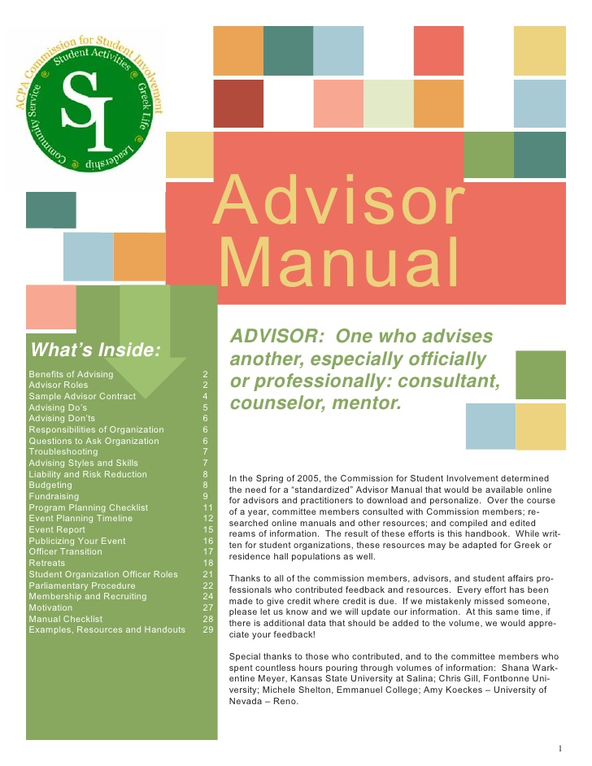
Advisor Resources
Advisor Manual
There’s a manual for this? YES! The American College Personnel Association (ACPA) is an international conference for college student educators, and they’ve crafted a Field Guide for student organization advisors. Check it out here!
(URL: https://www.myacpa.org/docs/acpaadvisormanualpdfpdf)

Slide 18

Advisor Resources
GatorXperience
SF State’s very own portal for all things student orgs and involvement can be found on our GatorXperience.
(URL: https://sfsu.campuslabs.com/engage/)

Slide 19
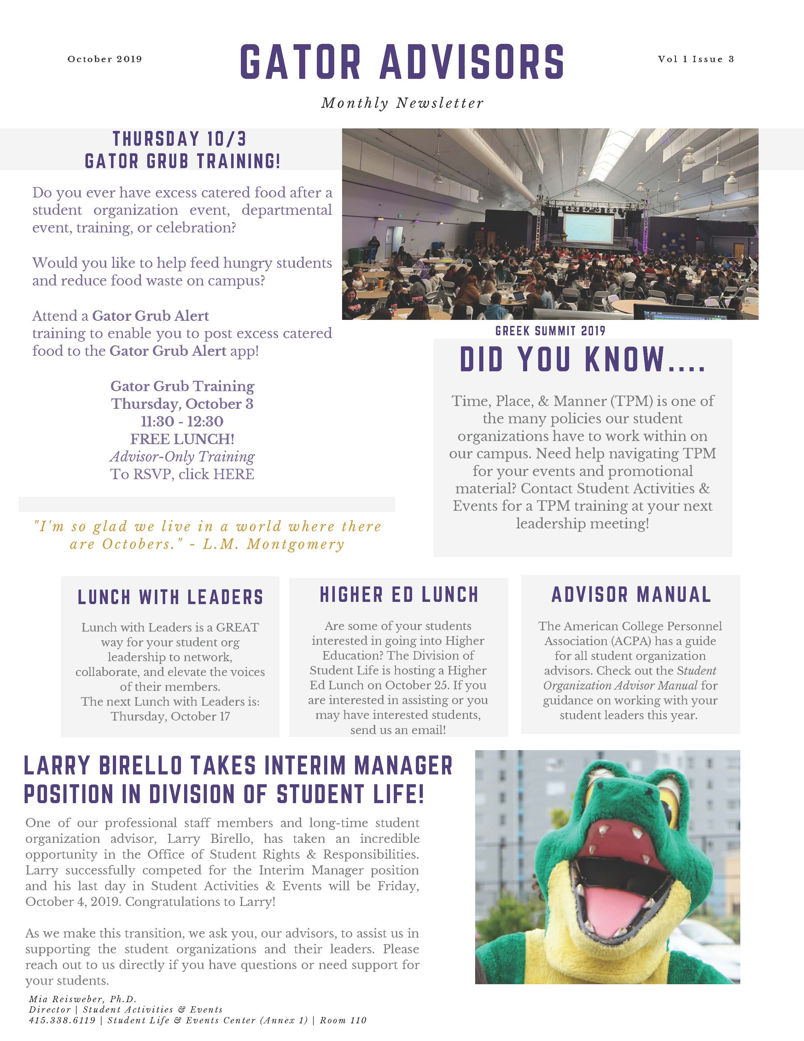
Advisor Resources
Student Activities & Events
SA&E has a wealth of resources for YOU, from Advisor-only workshops, to advisor-only listservs, and individualized 1:1 consultations, brainstorming sessions (complete with campus walks or coffee breaks!), and everything in between. Connect with us today!

Slide 20
Major Policies

Slide 21
Major Policies & Procedures
Remember one of the roles of an advisor is to be the Policy Interpreter for all things Student Organizations. We’ve got some helpful policies in this section AND some helpful links. Don’t hesitate to reach out directly and ask for support from Student Activities & Events
CSU Executive Order 1068
All student organizations in the CSU system are directed by EO 1068. As advisors, we expect you to know the ins and outs of this policy to continue to support your student organizations.
(URL: https://calstate.policystat.com/policy/6591312/latest/)
Time, Place, and Manner
Every entity affiliated with, physically visiting, and/or interacting with SF State property is required to adhere to the Time, Place, and Manner policy. This is a good one to know, as well, not only for your student organizations but as a faculty or staff member at SF State!
(URL: https://vpsaem.sfsu.edu/sites/default/files/SFSU_Time_Place_and_Manner_Policy.pdf)

Slide 22
Major Policies & Procedures
Extended Absence Policy
All student organizations must have a contingency plan for if the advisor heads out on sabbatical or extended leave from the university. Work with your student organization to identify a back-up advisor in the event that you need an emergency leave. This way, your student organization won’t miss out on critical operations in your absence.
Resignation / Advisor Replacement Policy
If you are in need of resigning your position as advisor of your organization, you must do so in writing and inform not only the student organization but also Student Activities & Events staff, as well. Resignations can be made via email to activities@sfsu.edu. If you do not inform the department and the student organization in the same email, you have not successfully resigned your position and are still held accountable as advisor to the student organization.

Slide 23
The Heart of Student Organizations

Slide 24
The Heart of Student Organizations
Student Organizations must operate independently from their advisors
As an advisor, you must allow for your student organization to operate under your advisement, not your direction. Encourage, motivate, support, and hold space for growing and development. If you ever believe the integrity of the students, the organization, or SF State is compromised, please immediately reach out to the leadership team of Student Activities & Events (activities@sfsu.edu) or the Dean of Students Office (dos@sfsu.edu).
Student Orgs are opportunities for students to grow and develop
As you develop your advisor philosophy, remember that the purpose of student organizations at universities is for student to grow and develop through co-curriculum. Growth is in both success and in failure. Growth is in trial and error. Growth is in conflict and tension. Growth is in events and non-events. As you work with your student leaders each year, make space for intentional conversations and reflection in leadership roles, event debriefings, and annual lessons learned. Above all, enjoy these high impact moments with your students!

Slide 25
Contact Us
Student Activities & Events
Email / Website
activities@sfsu.edu
https://activities.sfsu.edu/

